Slide 1

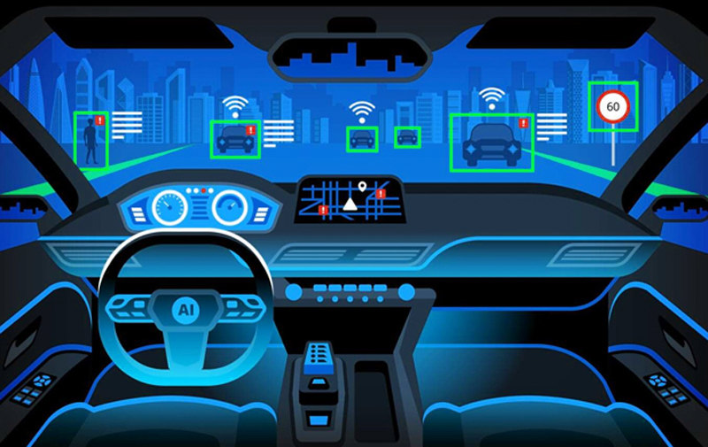
Signals & Systems for Automated Driving
Semester Project
Aditya Kumar
Igor Risteski
Md. Abul Khair

Slide 2
Outline
Type of sensors and associated noise
Types of Filters
Developed simulation environment for the project
ADAS Function: ACC and CAS combined
ADAS Function: Lane Merging

Slide 3
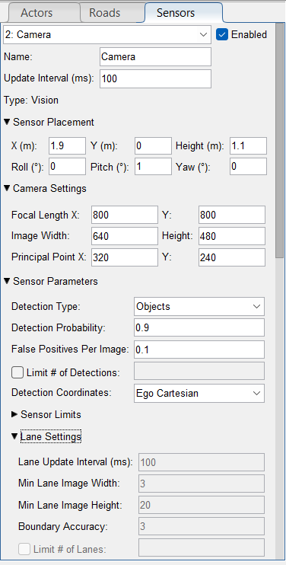
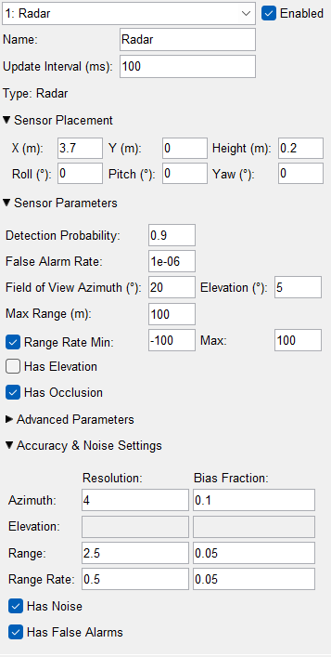
Types of Sensors and Noise
Radar: Distance, Radial Speed, Angle Noise: Motion, Interference, clutter
Lider: Distance, Multi Angle, scanning Noise: Environment(sunlight), reflectivity
Camera: Projection, lane tracking, Distance Noise: Environment(Dark), Compression, Lens Flares
Notes:
False Alarms: Noise can cause the radar to incorrectly identify objects that aren't there.
Missed Detections: Weak signals from real objects may be masked by noise.
Reduced Resolution: Noise can limit the radar's ability to distinguish between closely spaced objects.
Inaccurate Measurements: Positional data (range, angle, velocity) can be affected, impacting tracking and mapping systems.
Preprocessing like outlier removal and filtering
Postprocessing like clustering and segmenting

Slide 4
Types of filters
Batch Expression: Computationally expensive
Average Filter: For static signal
Moving Average Filter: Equal weighting
Low Pass filter: Static Weighting
Kalman Filter: Dynamic

Slide 5
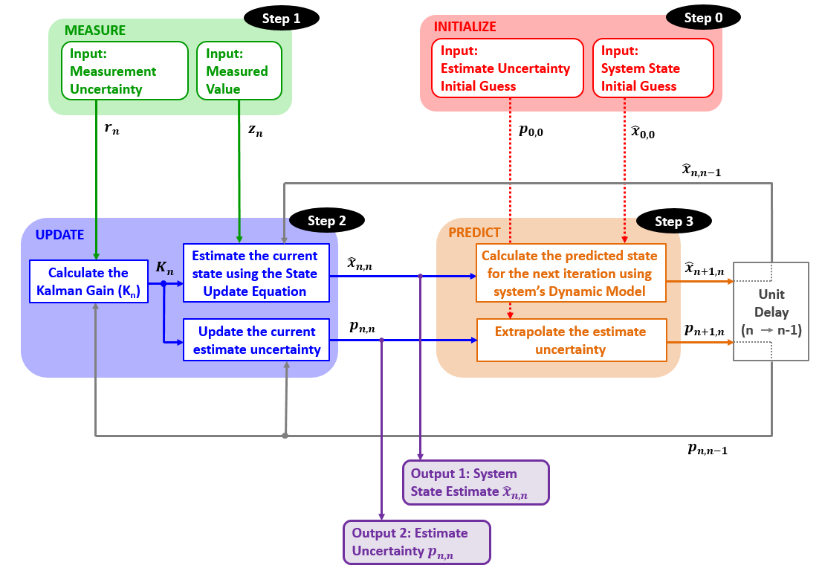
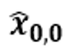
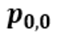
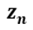
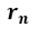
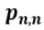

The Kalman Filter
Step 0: Initialization
Initial System State ( )
Initial State Variance ( )
The initialization is followed by prediction.
Step 1: Measurement
Measured System State ( )
Measurement Variance ( )
Step 2: State Update
The state update process is responsible for the state estimation of the current state of the system.
The state update process inputs are:
Measured Value ( )
A Measurement Variance ( )
A prior Predicted System State Estimate ( )
A prior Predicted System State Estimate Variance ( )
Based on the inputs, the state update process calculates the Kalman Gain and provides 2 outputs:
Current System State Estimate ( )
Current State Estimate Variance ( )
These parameters are the Kalman Filter outputs.
https://www.kalmanfilter.net/default.aspx
Step 3: Prediction
The prediction process anticipates the current system state estimate and its variance to the next system state based on the dynamic model of the system.
At the first iteration, the initialization is treated as the Prior State Estimate and Variance.
The Prediction outputs are used as the Prior (predicted) State Estimate and Variance in the following filter iterations.

Slide 6
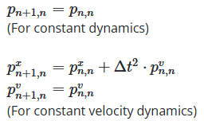
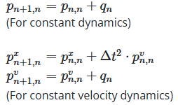
The Kalman Filter
Kalman Gain
Process Noise
The Kalman Gain is a number between 0 ≤ Kn ≤ 1, that defines the measurement weight and the prior estimate weight, when forming a new estimate.
There are often uncertainties in the system dynamic model. These uncertainties, are called Process Noise. The Process Noise is denoted by the variable ωn, and the Process Noise Variance is denoted by the letter q.
This provokes changes in the covariance extrapolation equation. Without noise: With noise:
State update equation:
where,
(Kn) is the measurement weight, and (1 - Kn) term is the weight of the current state estimate.
If the measurement uncertainty is high, and the estimate uncertainty is low, the Kalman Gain is close to 0. This means that significant weight is given to the estimate, and small to the uncertainty. If the opposite is the case, then the Kalman Gain is close to 1. If both the measurement and estimate are equally uncertain, the Kalman Gain equals 0.5.

Slide 7
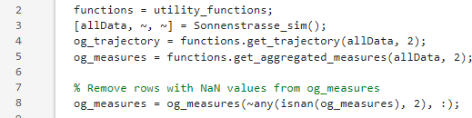
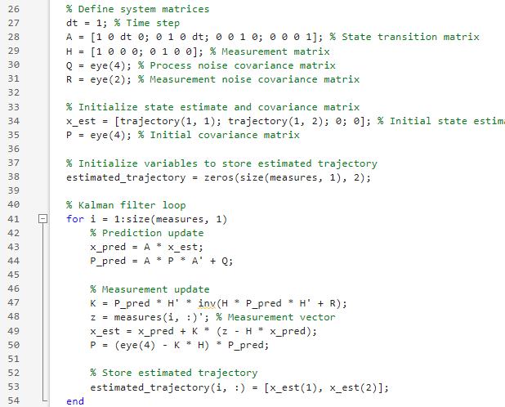
The Kalman Filter
In our Matlab implementation, the Kalman filter for a given scenario is defined in the following way:
Initially we collect data from the simulation environment using two different functions: one for the trajectories and one for measurements.
The time step and matrices are then defined, the predicted trajectory is recorded in variables, and the Kalman filter is applied in a loop to all subsequent measurement data.

Slide 8
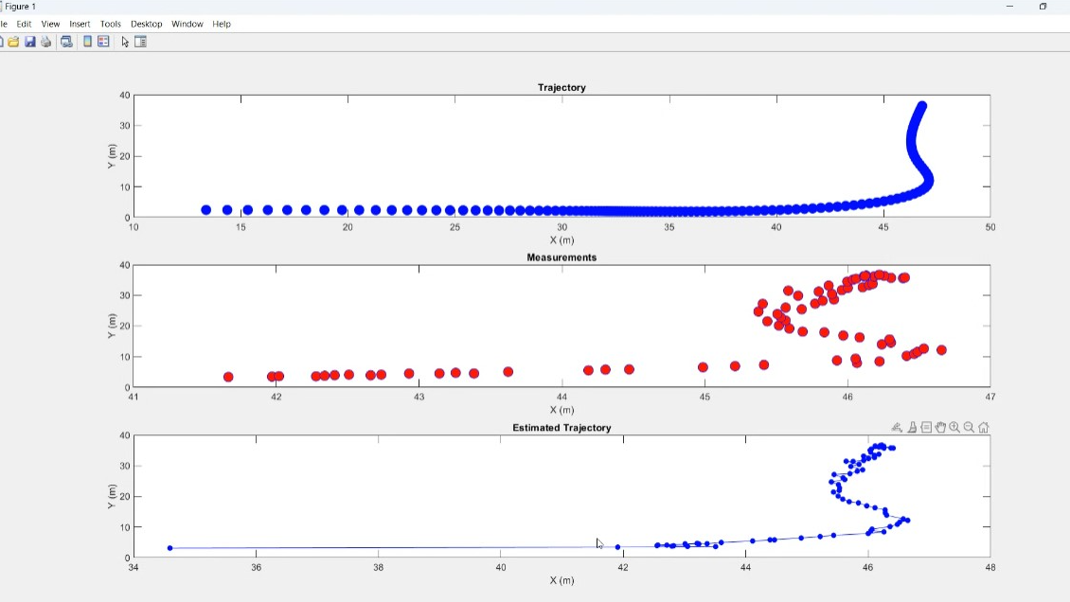
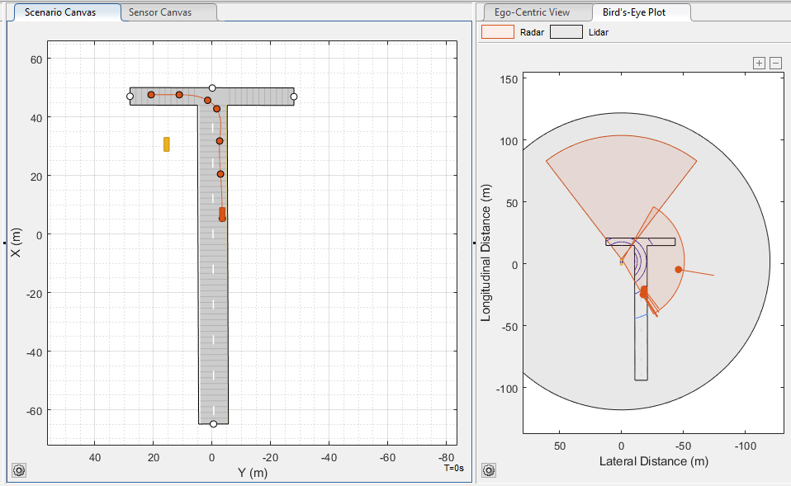
Kalman Filter for Simulated Radar
After setting up the utility functions and making the Kalman filter script, the next step is creating a scenario, in order to test it out. For this purpose, we are using the “Driving Scenario Designer” addon within Matlab. the inititial scenario consists of: creating a street and 2 vehicles, one of which is moving along the road, and the other is stationary, outside of the road, then setting up the stationary vehicle as an Ego vehicle, and putting sensors on it. This vehicle is therefore “watching” the moving vehicle, and gathers the data from the sensors, which the Kalman filter will later use and plot the trajectory.

Slide 9
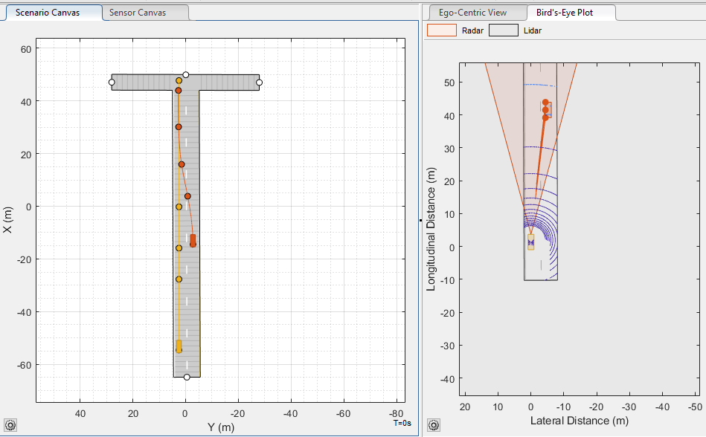
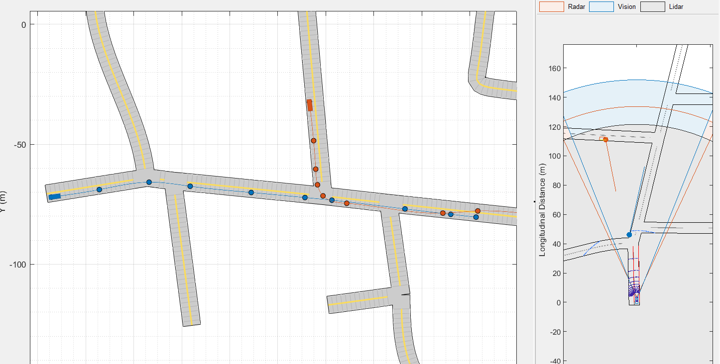
Project Scenario Simulation

Slide 10
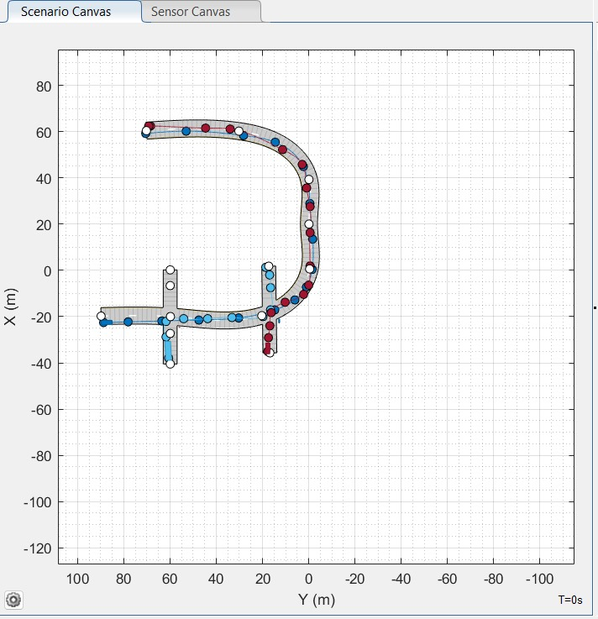
Implementing ADAS Function: ACC and CAS
While choosing which ADAS function to implement, we agreed that the simplest one would either be Lane Keeping, or Adaptive Cruise Control. We chose the ACC function combined with CAS. To implement this, we used the following scenario.

Slide 11
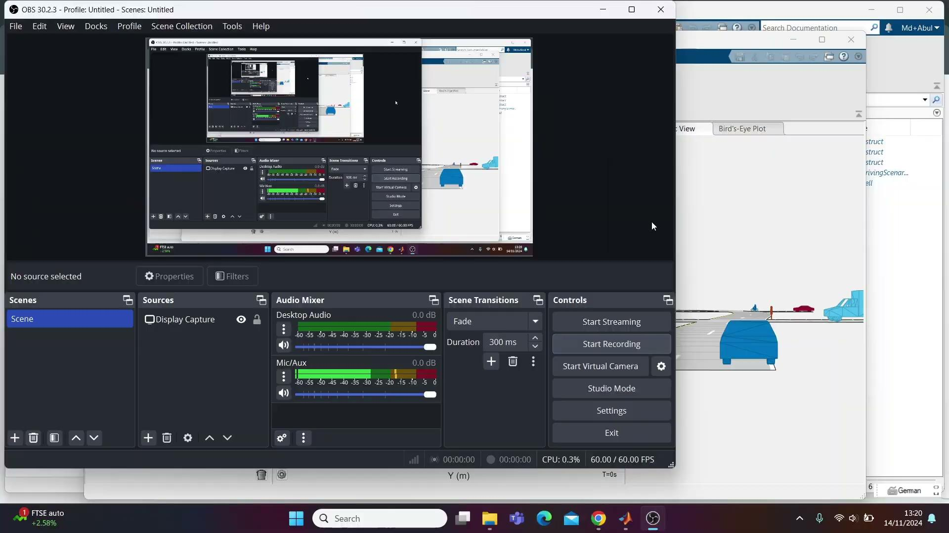

Slide 12
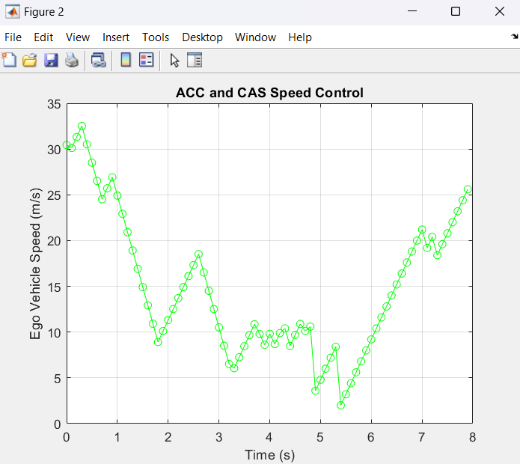
Implementing ADAS Function: ACC and CAS
This figure shows the velocity changes over time for raw data

Slide 13
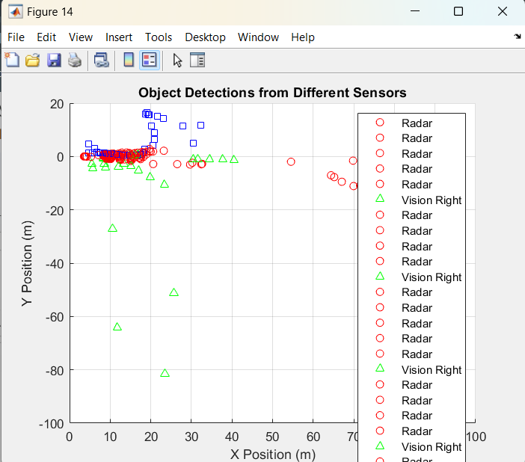
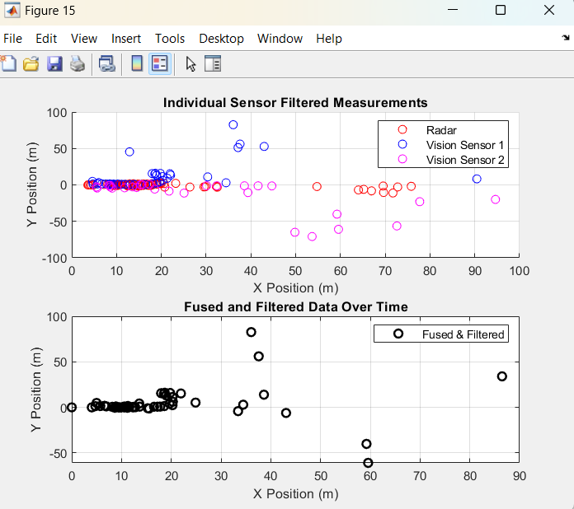
Before Filtering and Fusion
After Filtering and Fusion

Slide 14
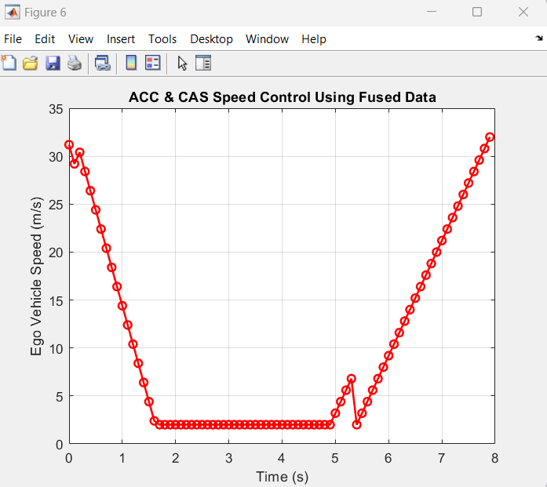
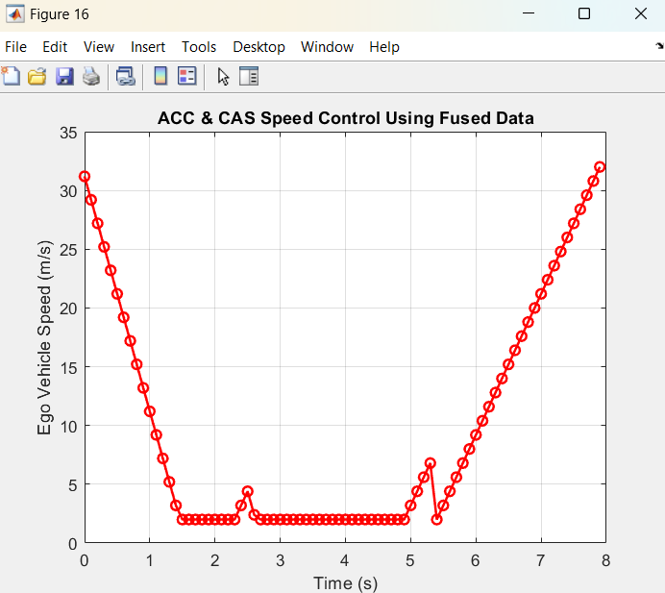
Static Weighted Average Fusion
Adaptive Weighted Average Fusion

Slide 15
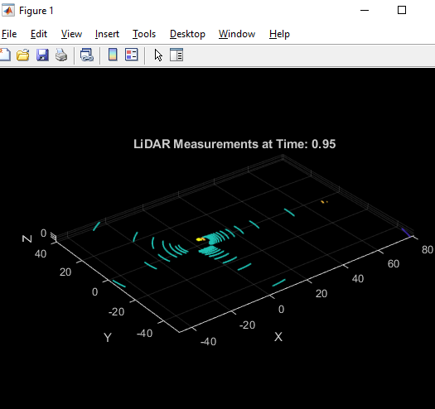
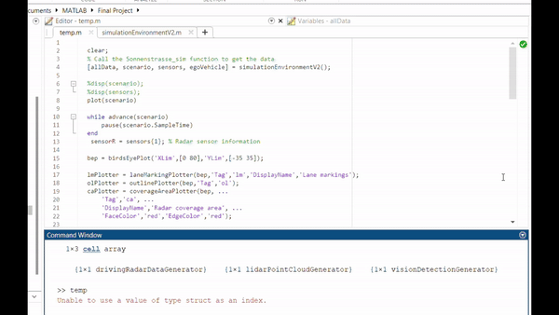
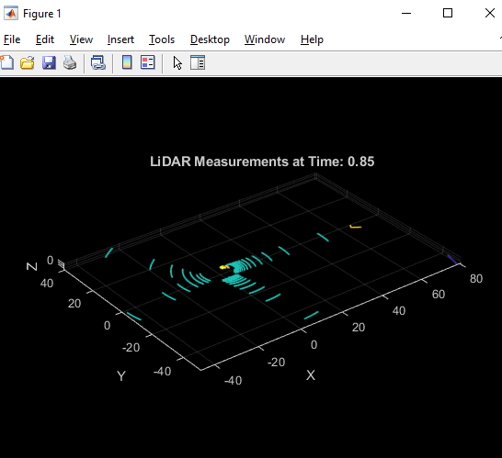
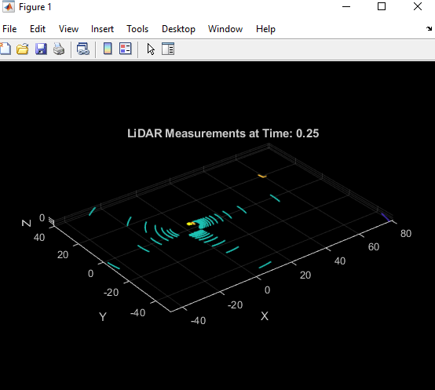
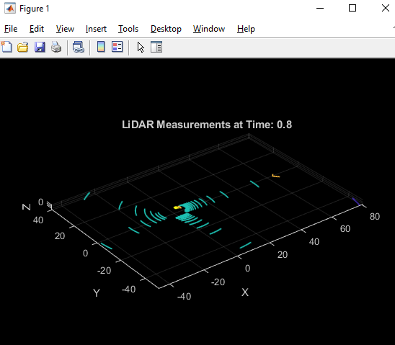
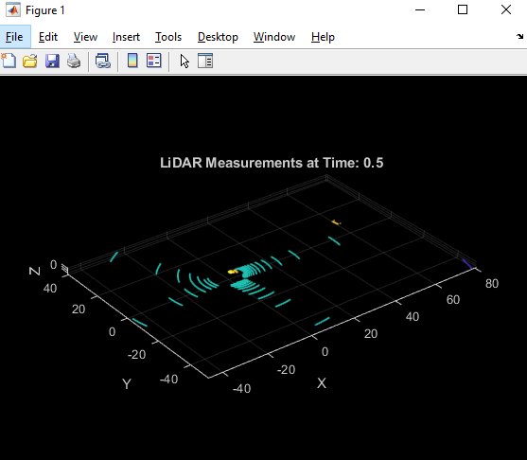
ADAS Implementation: Lane Merging

Slide 16
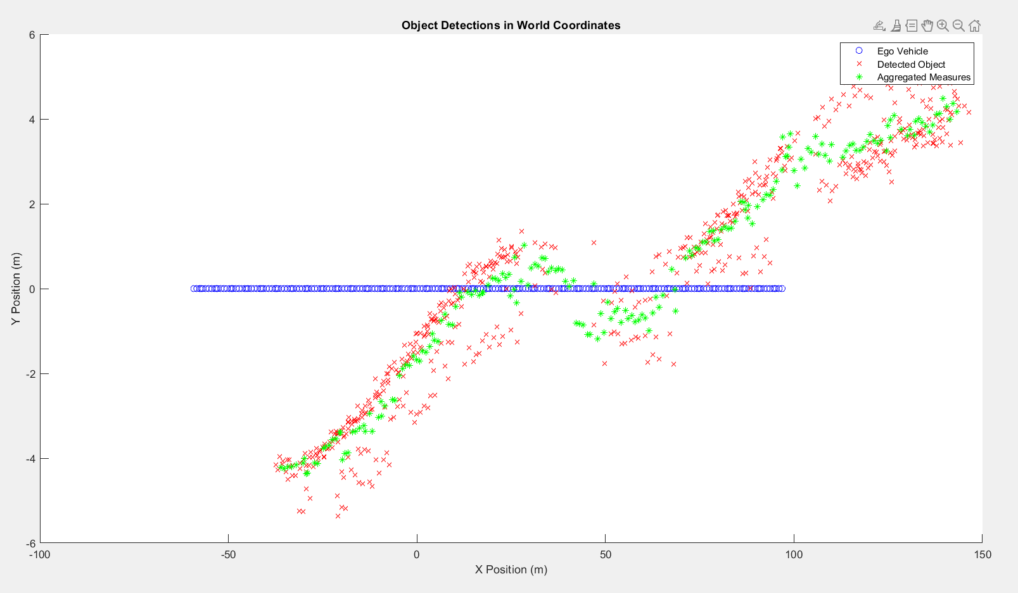
ADAS Implementation: Lane Merging

Slide 17
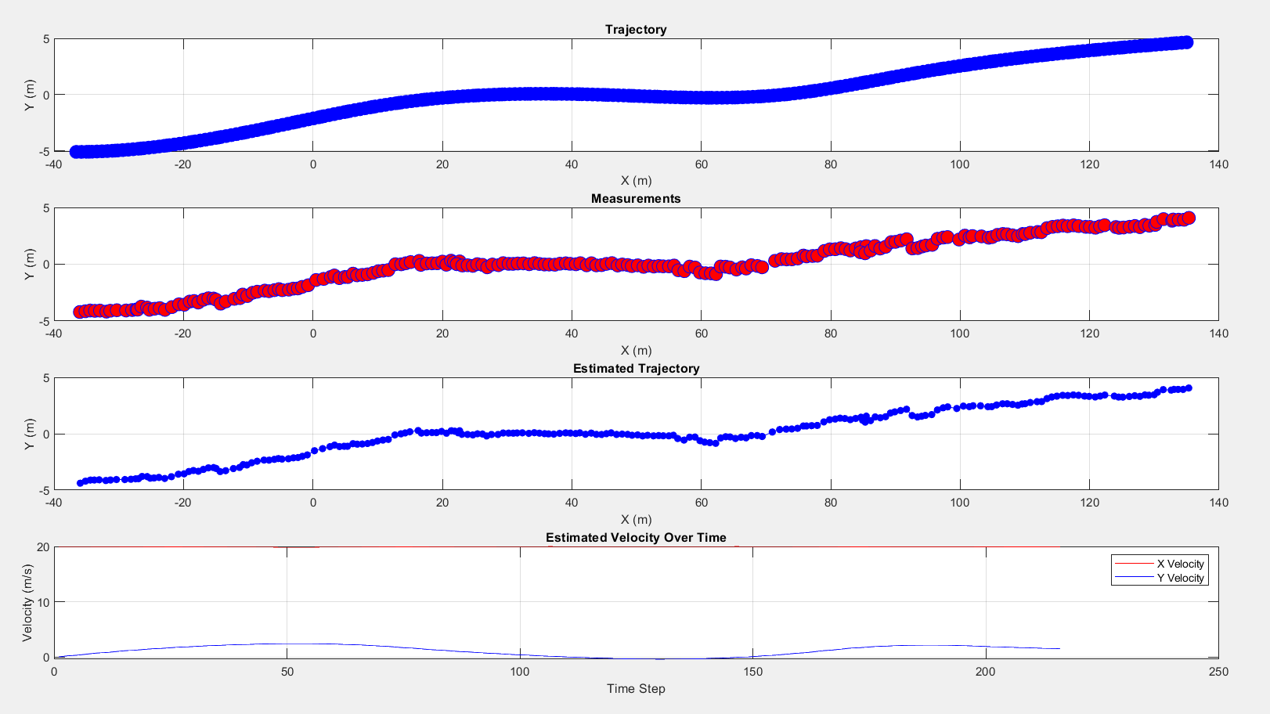
ADAS Implementation: Lane Merging

Slide 18
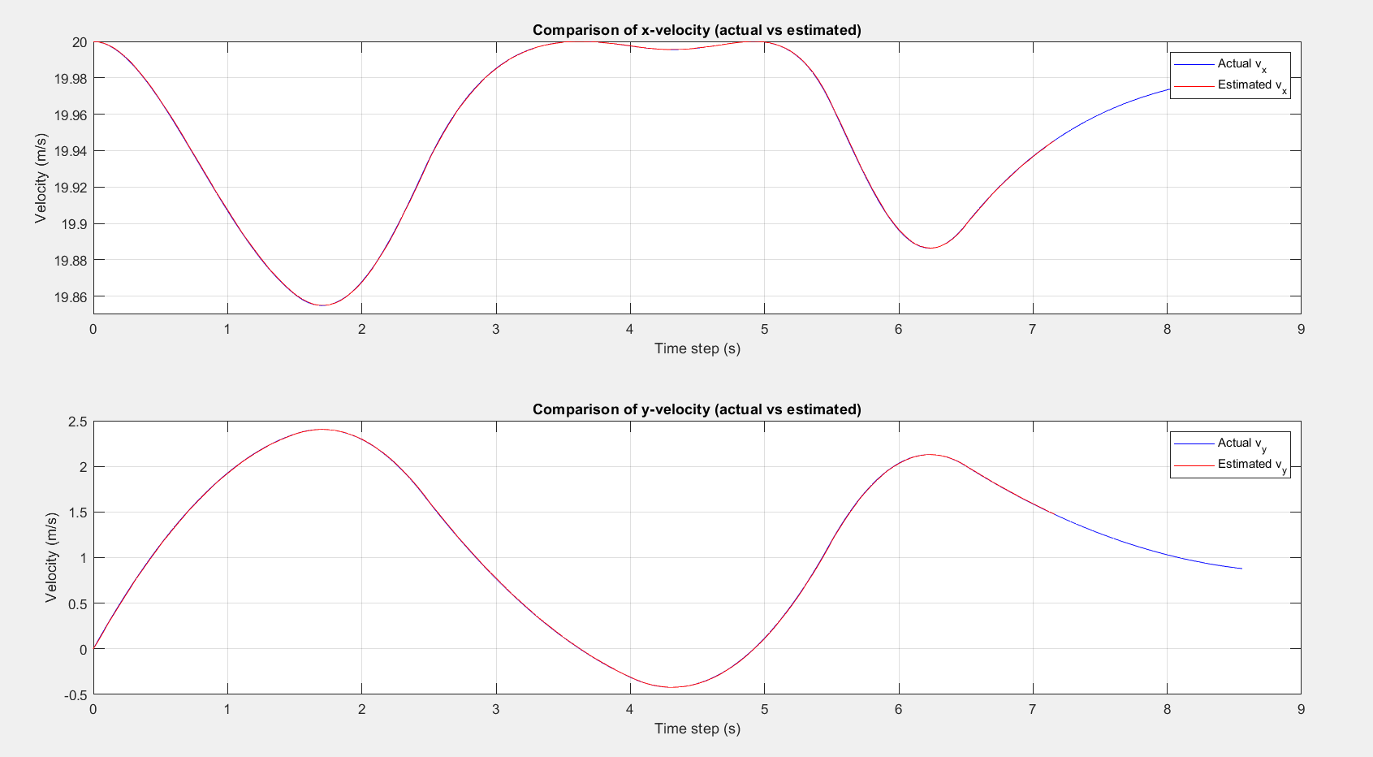
ADAS Implementation: Lane Merging

Slide 19
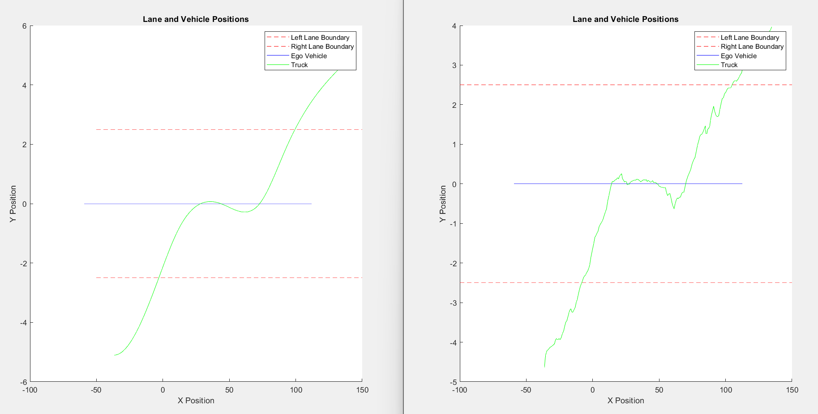
ADAS Implementation: Lane Merging

Slide 20
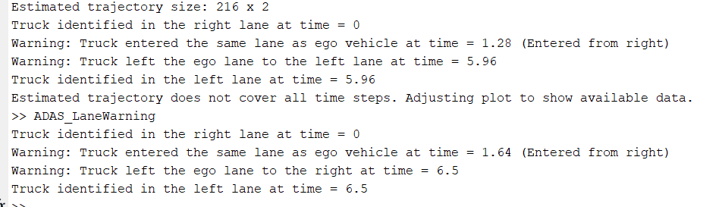
ADAS Implementation: Lane Merging

Slide 21
Thank you for your attention !

